Slide 1
Lab #C - Vision isppipeline_HDR
111061545 陳揚哲
111061529 周子翔

Slide 2
Outline
Introduction to isppipeline_HDR
The block diagram of isppipeline_HDR
L3 function
L2 and L1 function
Problems encountered

Slide 3
Introduction to isppipeline_HDR
Isppipeline_HDR(Image Sensor Processing pipeline_HDR)
Isppipeline is one main topic in Vision.
When sensor collect the data, to generate the image with better quality, the data needs to be processed(Image Sensor Processing)

Slide 4
Introduction to isppipeline_HDR
HDR(High Dynamic Range) is used to generate the image has high dynamic range.
If there’s image with high intensity difference, imaging without pre-processing would lead to overexposure and dark area.
HDR is the image process method keeps the detail of overexposure and dark area.

Slide 5
The block diagram of isppipeline_HDR

Slide 6
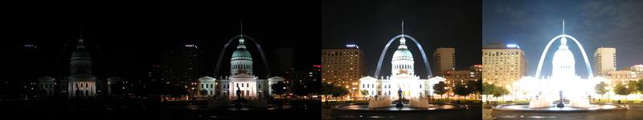
The block diagram of isppipeline_HDR - HDR Merge
Use two images with different exposure. Collect the bright pixel of low exposure image, dark pixel of high exposure image.

Slide 7
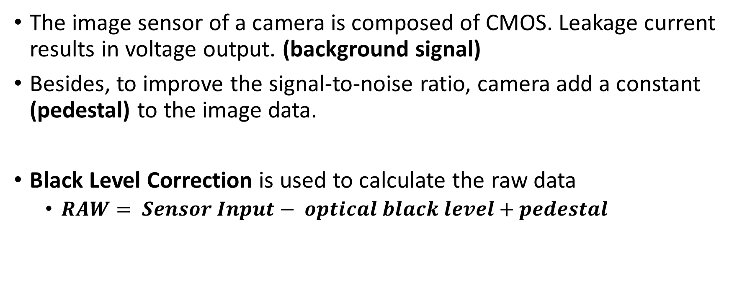
The block diagram of isppipeline_HDR - Black Level Correction
The image sensor of a camera is composed of CMOS. Leakage current results in voltage output. (background signal)
Besides, to improve the signal-to-noise ratio, camera add a constant (pedestal) to the image data.
Black Level Correction is used to calculate the raw data
$RAW= Sensor Input− optical black level+pedestal$

Slide 8
The block diagram of isppipeline_HDR - Gain control
Gain control can improve the overall brightness of the input image, improve the contrast and visual effect of the image
The red and blue channels of the input Bayer format image are multiplied by a gain (weight)
since the green channel of the Bayer format is determined by both the red and blue channels.

Slide 9
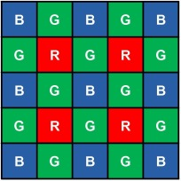
The block diagram of isppipeline_HDR - Demosaic
Bayer data format has only one of R, G, or B in each pixel.
Demosaic is to re-generate the pixel data in normal data format(RGB).
Commonly use interpolation.

Slide 10
The block diagram of isppipeline_HDR - AWB(Auto White Balance)
AWB adjusts the color balance of an image to compensate for variations in lighting conditions.
Analyze the overall color distribution in the image to estimate the appropriate color correction.

Slide 11
The block diagram of isppipeline_HDR - CCM(Color Correction Matrix)
CCM is a technique used to adjust the color balance of an image to match a known or desired color reference.
It works by applying a matrix transformation to the color channels of the image to adjust their color balance.

Slide 12
The block diagram of isppipeline_HDR - Q & D(Quantization & Dithering)
Quantization： Reduce 16 bits signal to 8 bits.
Dithering：Dithering introduces small amounts of noise to the image to create a more natural-looking pattern. Generate smoother image.

Slide 13
The block diagram of isppipeline_HDR - Gamma correction
Gamma Correction is a common technique used to enhance the contrast and brightness of an image.

Slide 14
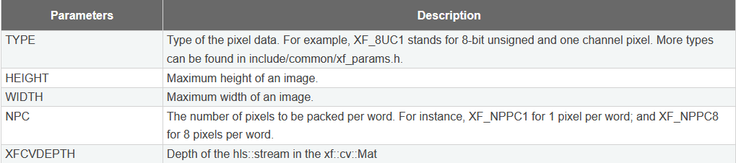
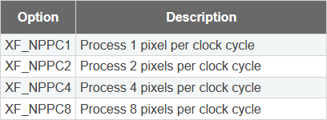
L3 function
Define the xf::cv::Mat is an image container class
(Type, Height, Width, NPC, XFCVDEPTH)

Slide 15
L3 function

Slide 16
L3 function
Use for pipeline

Slide 17
L3 function

Slide 18

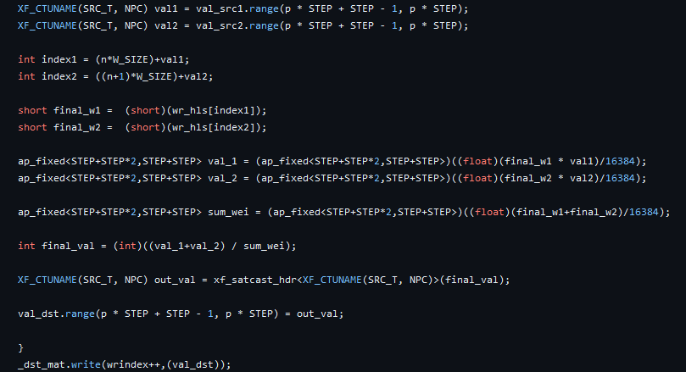
L2 and L1 function
HDR Merge

Slide 19
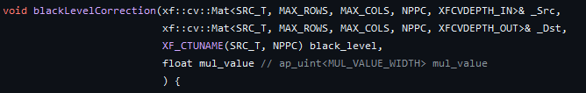
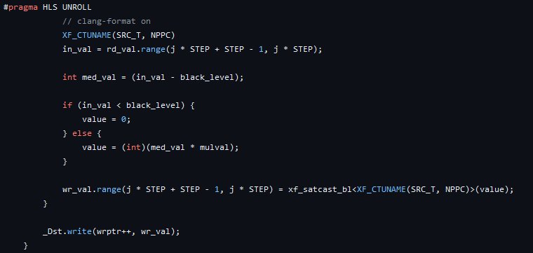
L2 and L1 function
Black Level Correction

Slide 20
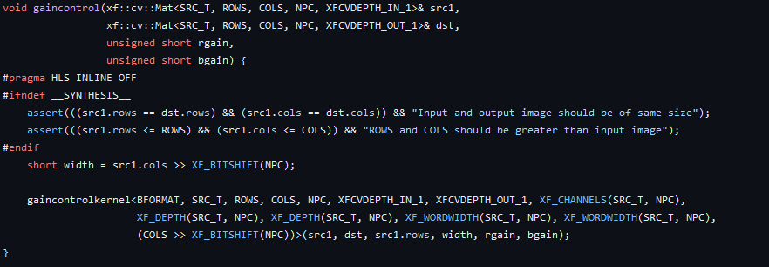
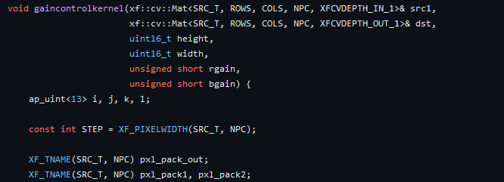
L2 and L1 function
Gain control

Slide 21
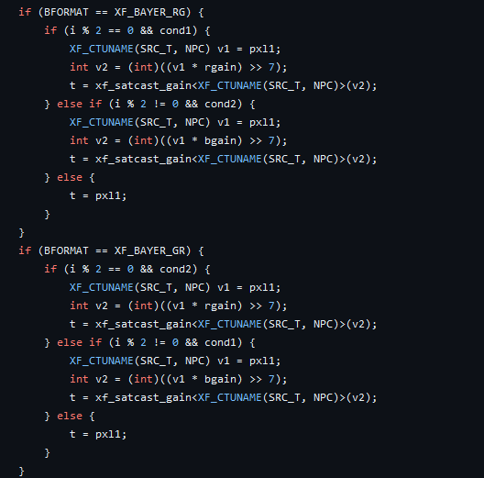
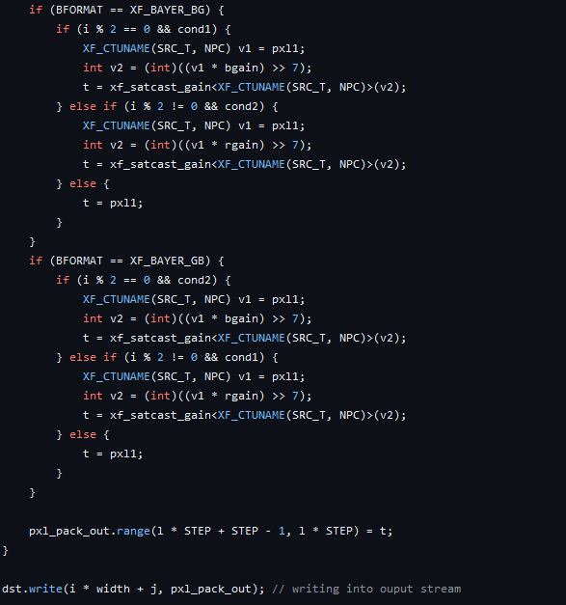
L2 and L1 function

Slide 22
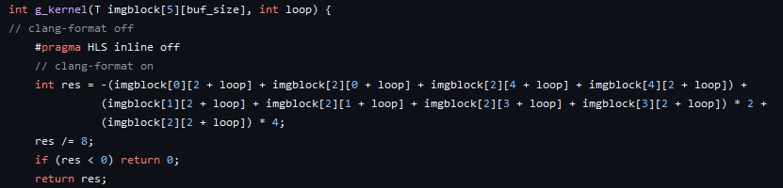
L2 and L1 function
Demosaicing

Slide 23
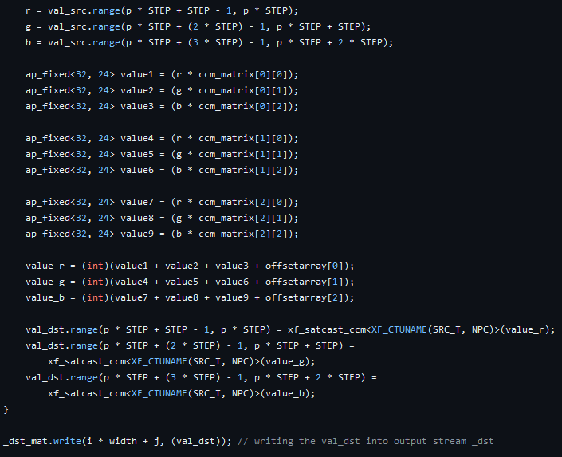
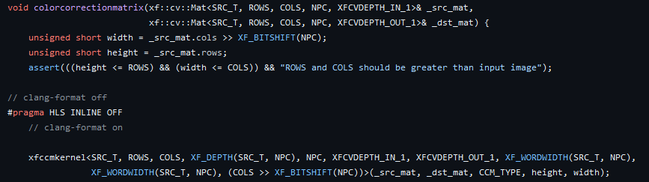
L2 and L1 function
Color Correction Matrix

Slide 24
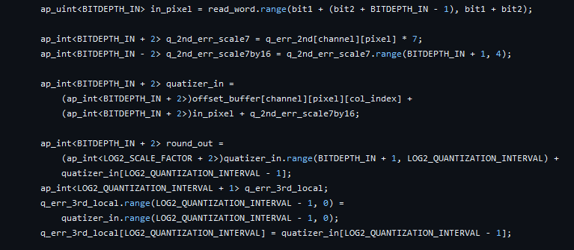
L2 and L1 function
Quantization

Slide 25
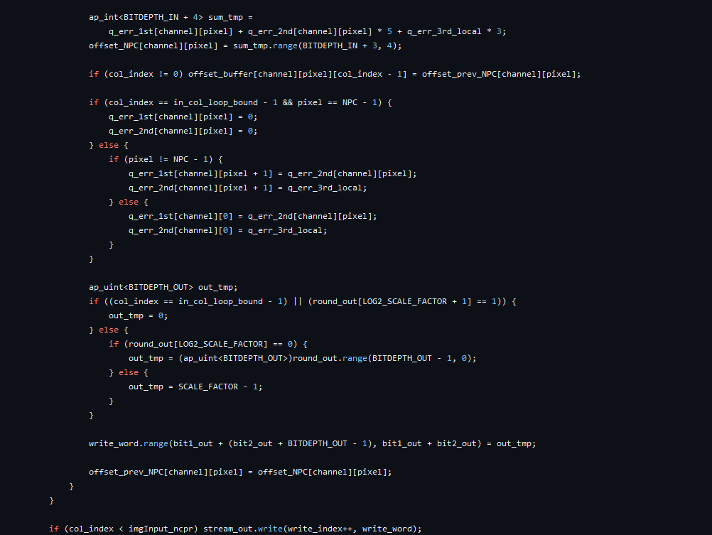
L2 and L1 function
Dithering

Slide 26
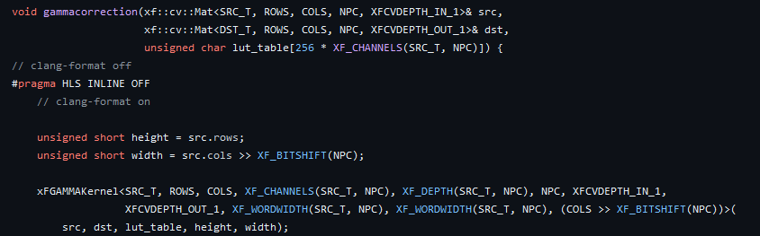
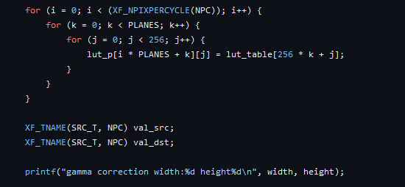
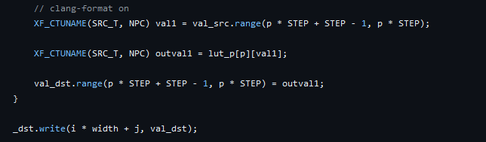
L2 and L1 function
Gamma correction

Slide 27
Problems encountered – OpenCV directory
https://github.com/bol-edu/HLS-Discussions/discussions/43
We need to include the xf_headers.hpp file, while the original code include the incorrect (relative) directory of opencv module.
Therefore, we modify the xf_headers.hpp file to the absolute directory.
We change the code ：
#include "opencv2/opencv.hpp“
#include "/usr/local/include/opencv4/opencv2/opencv.hpp"

Slide 28
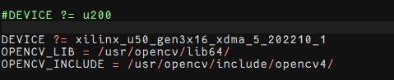
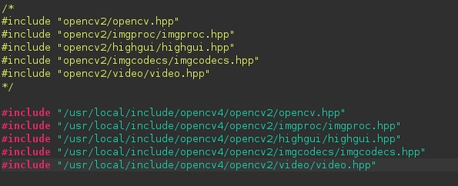
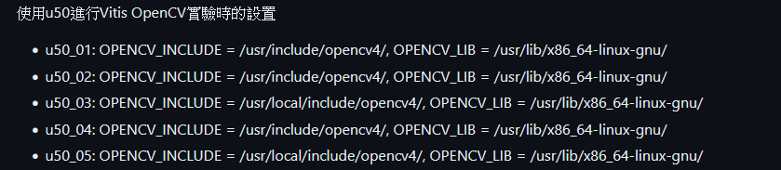
Problems encountered – OpenCV directory

Slide 29
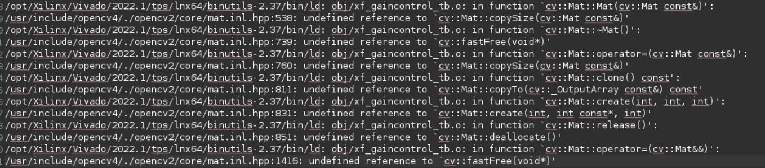
Problems encountered – undefined reference
Can’t find the reference of the OpenCV library.
Setting up the linker flag to solve the problem.

Slide 30
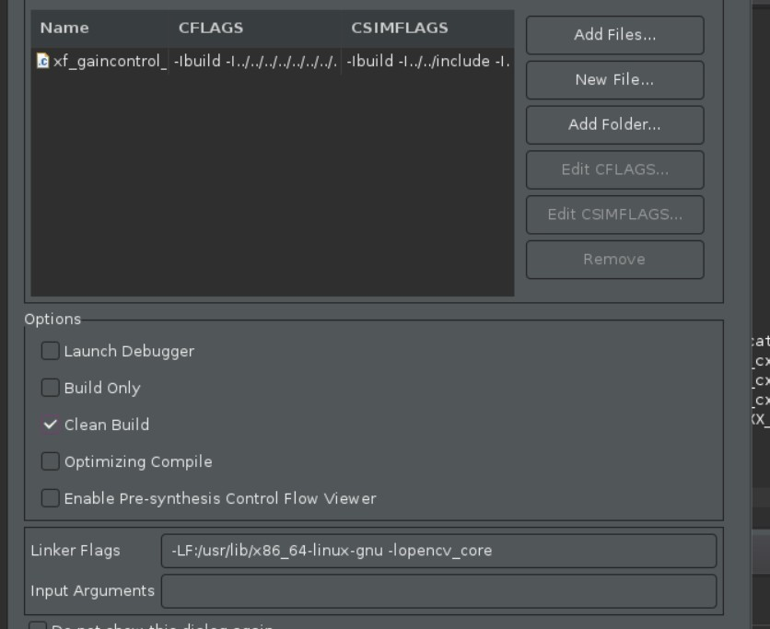
Problems encountered – undefined reference
Add the linker flag
-lopencv_videoio
-lopencv_imgcodecs
-lopencv_core
-lopencv_imgproc
-lopencv_features2d
-lopencv_flann
-lopencv_video
-lopencv_calib3d

Slide 31
Problems encountered – undefined reference
The problem of gcc but we don’t know how to solve.

